Slide 1
Project Presentation

Slide 2
Feature Highlight

Slide 3
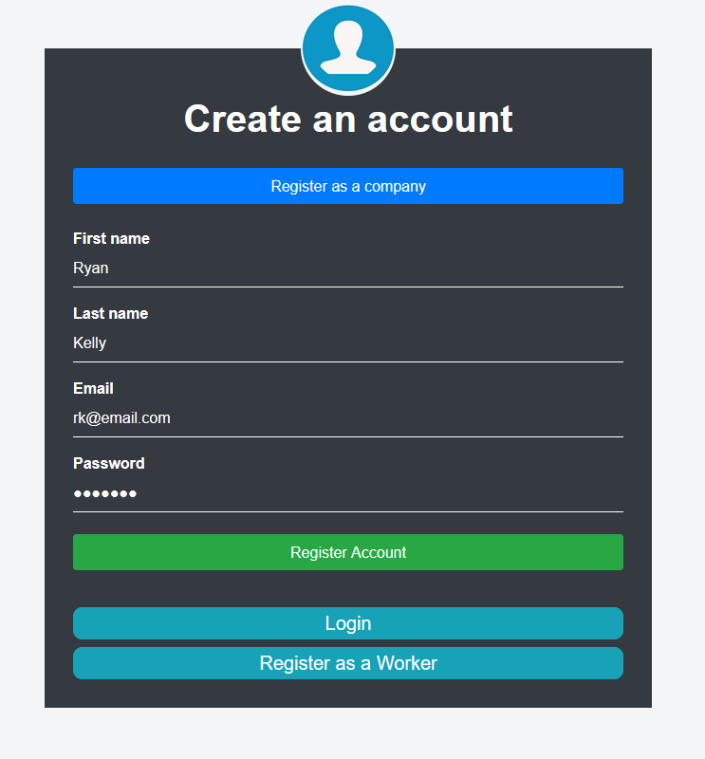
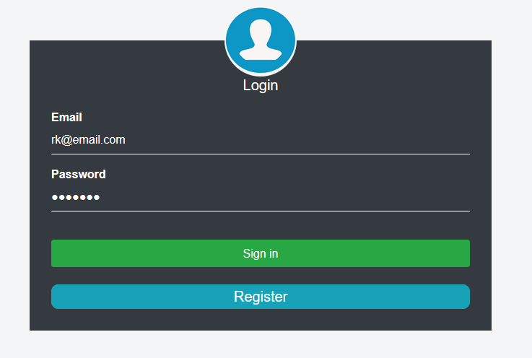
Login/Registration

Slide 4
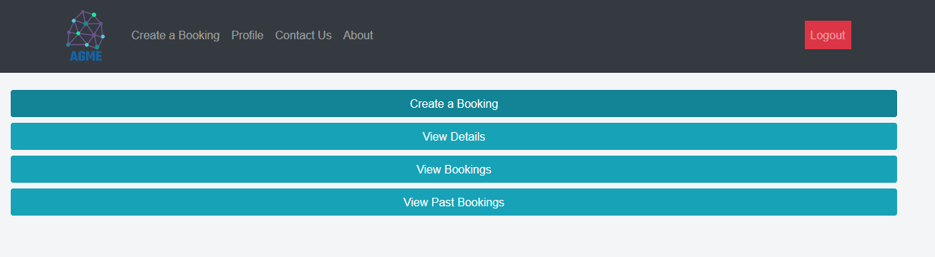
Home Page

Slide 5
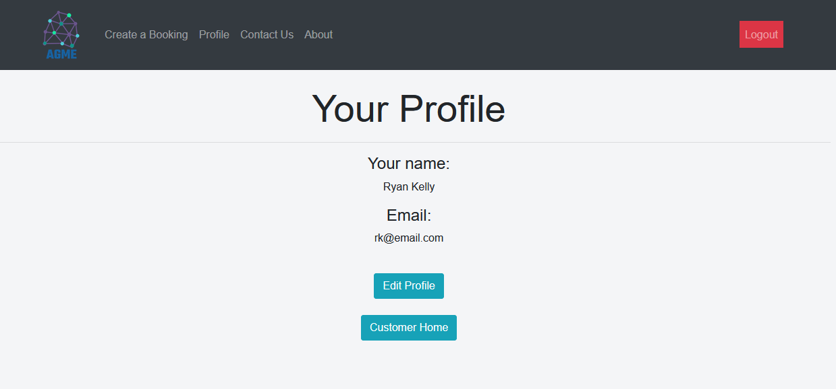
View Profile

Slide 6
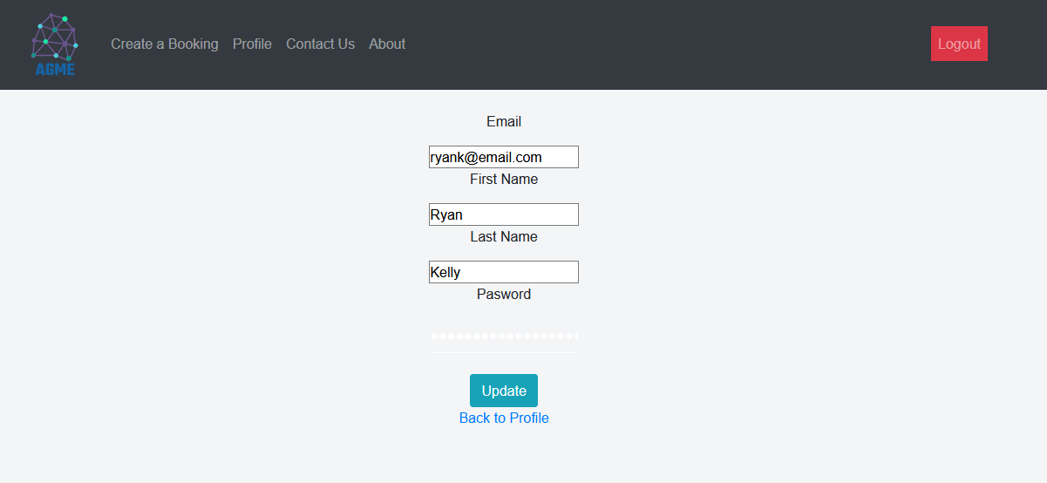
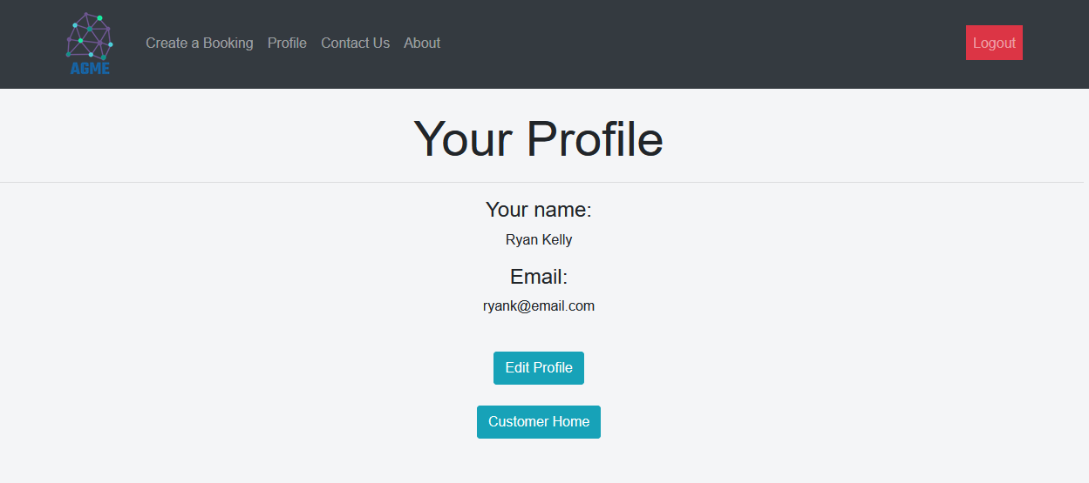

Slide 7
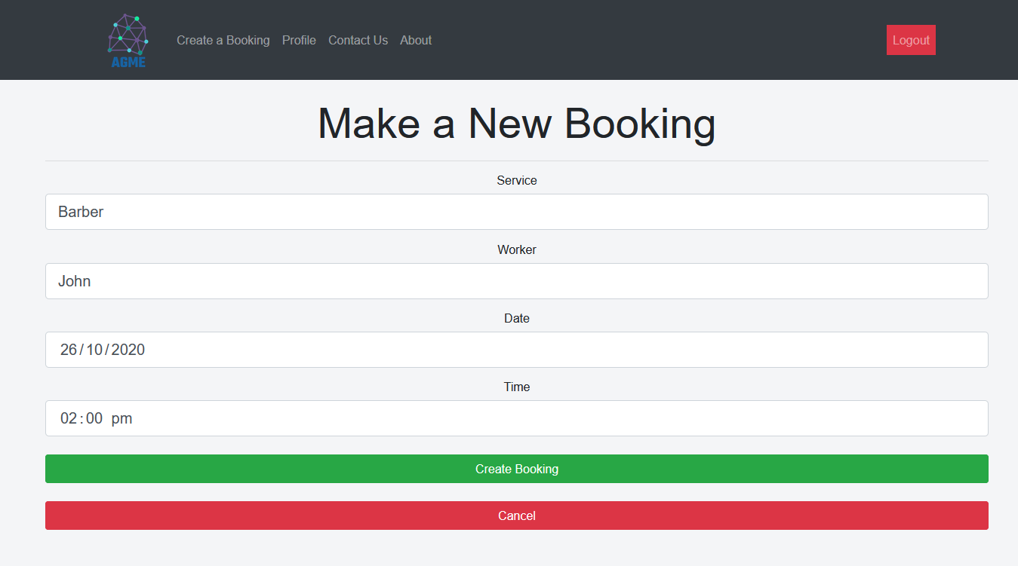
Make Booking

Slide 8
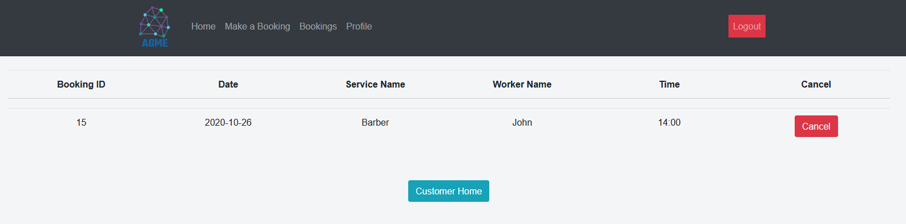
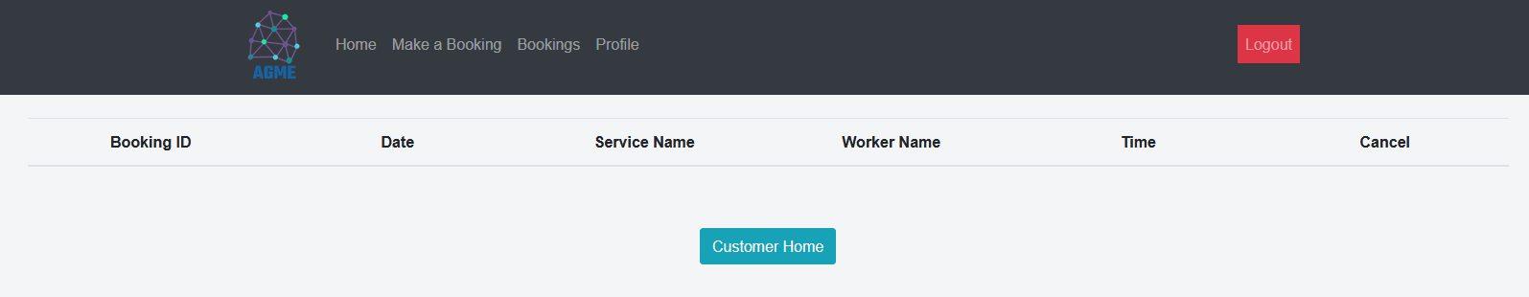
Cancel Booking

Slide 9
Retrospective

Slide 10
Sprint Retro (Muhammad Ali Tariq)
Things That Went Well
Things that went well for this project was the implementation of the tasks, they were implemented on time. Overall, we were able to develop a working project, so I think that went well too.
Things That Could Have Gone Better
Things that could have gone better were the team having integration as one of the higher priority. The team started integrating features at later stages which led to last minute changes in the code.
Things That Surprised Us
Things that surprised me was how simple features were to implement once the team started integration.
Lessons Learned
Overall, I got to know react and how frontEnd developing works. I was able to polish my backEnd skills too.

Slide 11

Sprint Retro (Mark Johnson)
Things That Went Well
The lengthened sprint time allowed us to complete more functionality
Things That Could Have Gone Better
The end of the semester having multiple final assignments due simultaneously.
Things That Surprised Us
Difficulty in producing things that would be simple in other languages (such as populating a dropdown menu from the database).
Lessons Learned
A lot about Springboot, React, and the Agile process through the undertaking of the project.

Slide 12
Sprint Retro (Ryan Kelly)
Things That Went Well
Trello board was well organised with well-defined user stories
We were able to produce a product by the end of the project
Things That Could Have Gone Better
Overall, communication was good, although it could have been improved slightly with more meetings
Things That Surprised Us
Was surprised about the amount of self-learning that was needed
Lessons Learned
Learned a lot about React, Spring Boot and REST API

Slide 13

Sprint Retro (Prabhav Mehra)
Things That Went Well
We were able to complete the back-end task completely.
The front end and the back-end team were well coordinated for this sprint and every function was integrated by the front-end team.
Held regular meetings and divided our tasks accordingly.
Things That Could Have Gone Better
Functionality for some parts such as the worker functionality could have been improved and made it more real-world use worthy.
Things That Surprised Us
We were provided with no help for the deployment part and even after mailing the tutor many times we got no response so that surprised us because we were stuck with something and that was not taught or explained enough in the class as well.
Lessons Learned
How to work as a team and how important communication is with team member and keeping everyone updated about our work.
Learned new skills. For example,springboot,react, aws which is proving to be very important as this point of time.

Slide 14

Sprint Retro (Kaushal Gawri)
Things That Went Well
We were to achieve maximum functionality in the backend.
Both the front end and back end team had great communication, task were divided accordingly as and everyone were able to finish their tasks
Regular meetings were held so that all the team members can coordinate better.
Deployment was finally completed even though we didn't have much resources for the same and neither the required skill set
Things That Could Have Gone Better
The functionality for worker registration could have been improved so that worker can have the feature to register himself dynamically and not through the admin users.
There were not much resources for AWS-deployment provided to us which made it very tough and the task was then delayed till last day of sprint.
Things That Surprised Us
No external help regarding the AWS deployment as there were not much resources available to us.
Functionality for dynamic worker registration which otherwise would have been easier in the backend.
Lessons Learned
Learned a lot about Spring-boot, React, Aws deployment including how different s3 buckets work well with the elastic-bean backend deployment
Got better in mostly all the agile methodologies.
We need to explore our resources a lot more rather than waiting for any external help

